Slide 1
ENVIRONMENTAL HEALTH COUNCIL OF NIGERIA (EHCON)
IN COLLABORATION WITH
AFRI TOURISM INVESTMENT LTD
WORKSHOP AND TRAINING PROGRAMME
AI & PREDICTIVE ANALYTICS DEMYSTIFIED (Machine Learning, Predictive Modeling, LLM Models, Data Analytics, NLP, Deep Learning)

Slide 2

Outline
Introduction to AI & Predictive Analytics
Machine Learning Foundations
Predictive Modeling & Data Analytics
Deep Learning and Neural Networks
Natural Language Processing (NLP)
Large Language Models (LLMs) & Generative AI
Integration: Predictive AI Meets Generative AI
Ethics and Governance

Slide 3
Introduction to AI & Predictive Analytics
AI revolutionizes how we analyze and act on data
Predictive Analytics forecasts future events using historical data & ML
AI enhances environmental health safety decisions
AI models helps in transforming data into insights

Slide 4
What is Predictive Analytics?
Predictive analytics involves using historical data, statistical algorithms, and machine learning techniques to forecast future outcomes.
It helps organizations predict incidents such as disease outbreaks, pollution spikes, or safety violations before they occur.

Slide 5
Key Concepts
Concept | Description
AI | Machines performing intelligent tasks
ML | Algorithms that learn from data
DL | Neural networks that mimic the human brain
NLP | Understanding and generating human language
LLMs | Large-scale models trained on text

Slide 6
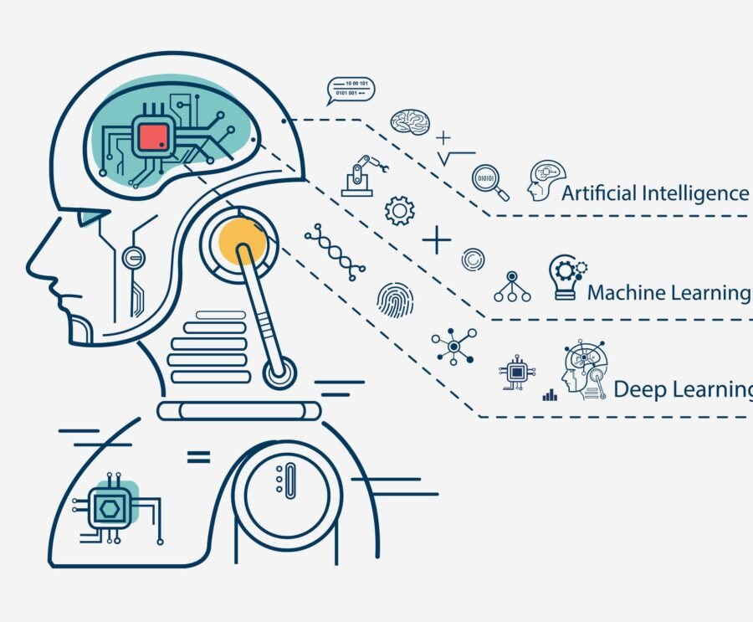
MACHINE LEARNING FOUNDATIONS
A subfield of artificial intelligence (AI) that uses algorithms to enable computers to learn from and make decisions or predictions based on data, without being explicitly programmed

Slide 7
Supervised vs. Unsupervised Learning
Supervised Learning
Model learns from labeled data
Unsupervised Learning
Model detects patterns without labels

Slide 8
ML Algorithms
Algorithm | Function
Linear Regression | Predicts continuous values
Decision Trees | Classification and decision-making
K-Means Clustering | Groups similar data
Random Forest | Ensemble learning for accuracy
Neural Networks | Pattern recognition

Slide 9
Data-to-Decision Pipeline
Data Collection
IoT sensors, field observations, databases
Data Preparation
Cleaning, formatting, anonymizing
Model Training
Learning patterns
Prediction
Generating actionable insights
Communication
Convert insights into reports & visuals

Slide 10
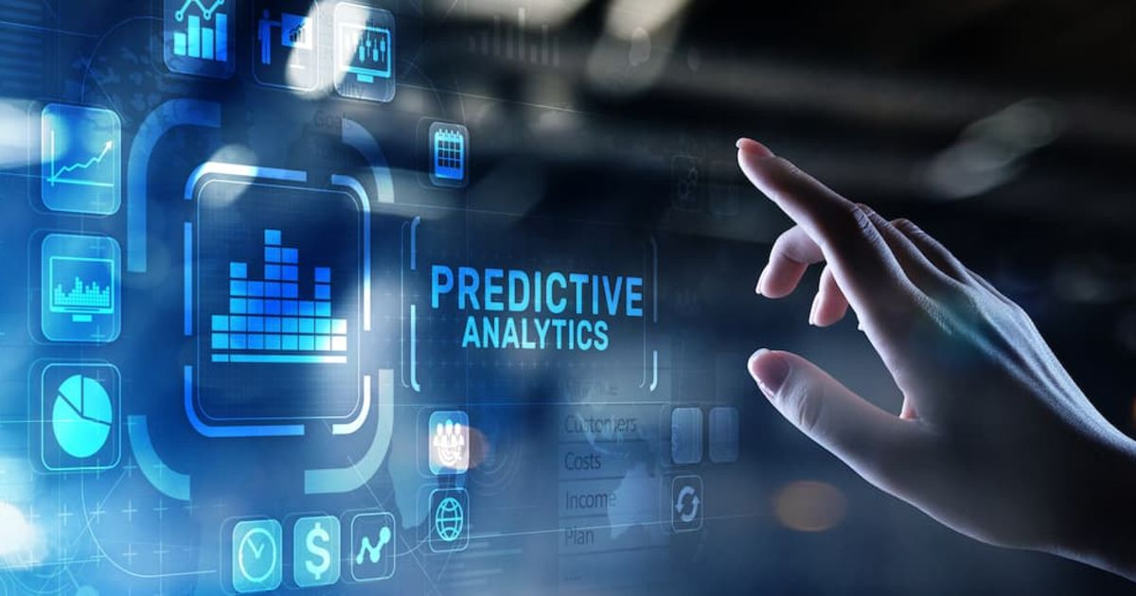
PREDICTIVE MODELING & DATA ANALYTICS
Predictive modeling and data analytics are interconnected fields that use statistical techniques, machine learning, and data mining to extract insights from data, uncover patterns, and forecast future trends or behaviors.

Slide 11
Predictive Modeling Steps
Define the Problem
Collect Data
Select the Model
Train and Validate
Generate Predictions
Present Findings

Slide 12
ML Algorithms
Category | Tools / Platforms | Use Case
Data Collection | Excel, Python, SQL | Cleaning and formatting datasets
Predictive Modeling | Python (Scikit-learn), R | Forecasting and classification
Visualization | Power BI, Tableau | Trend analysis and reporting
Generative & Communication | ChatGPT, Canva, Microsoft Copilot | Automated reports and campaign materials
Cloud Platforms | Google Cloud AI, AWS SageMaker | Large-scale model training & deployment

Slide 13
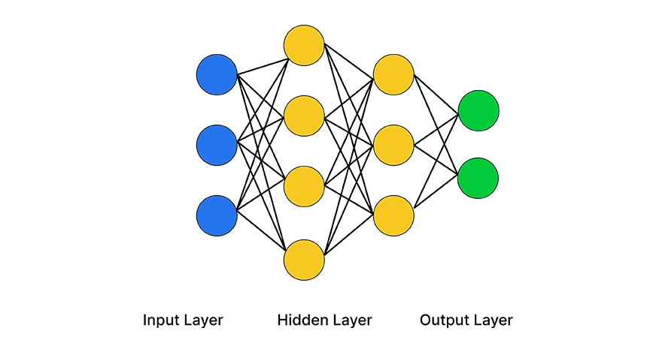
DEEP LEARNING AND NEURAL NETWORKS
Deep learning is a subset of artificial intelligence and machine learning that mimics the structure and function of the human brain through interconnected computational units known as neurons

Slide 14
Neural Networks Models
Model Type | Use Case | Description
Convolutional Neural Network (CNN) | Image Recognition | Identifying areas with waste accumulation from drone images
Recurrent Neural Network (RNN) | Sequential Prediction | Forecasting disease outbreaks over time
Autoencoder | Anomaly Detection | Detecting unusual pollution readings

Slide 15
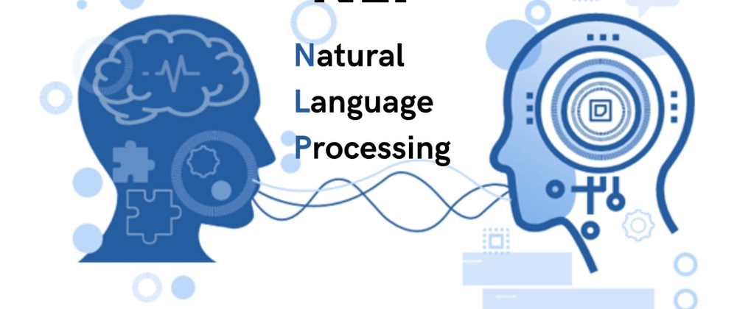
NATURAL LANGUAGE PROCESSING
Natural Language Processing (NLP) enables artificial intelligence systems to understand, interpret, summarize, and generate human language in meaningful ways.

Slide 16
Key NLP Functions
Function | Application
Text Classification | Categorize incident reports
Sentiment Analysis | Gauge public feedback on environmental programs
Text Summarization | Condense long policy documents
Machine Translation | Convert messages to local languages
Question Answering | AI-driven helpdesk for sanitation issues

Slide 17
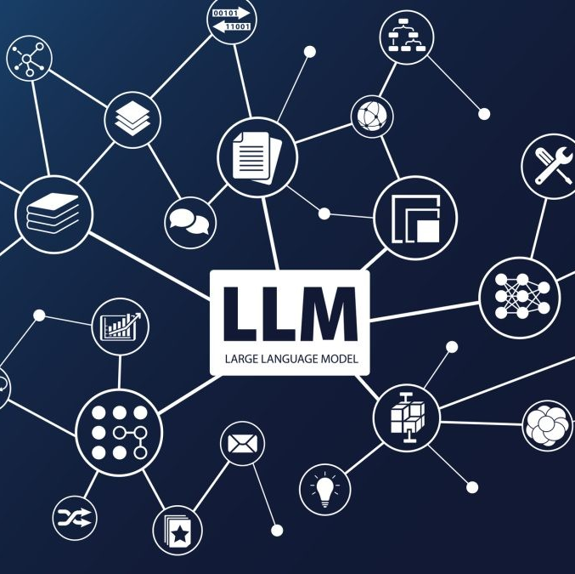
LARGE LANGUAGE MODELS (LLMs) AND GENERATIVE AI
Large Language Models like ChatGPT, Gemini, Claude, and Copilot are trained on vast datasets of text and code. They understand patterns, semantics, and context to generate coherent, human-like responses.

Slide 18
Predictive Modeling Steps
Tokenization
Encoding
Contextual
Generation
Processing

Slide 19
Use Cases
Function | Example
Data Interpretation | Explain trends in air pollution data
Awareness Campaigns | Create sanitation campaign scripts
Predictive Reports | Generate automated inspection summaries
Policy Support | Draft recommendations for national sanitation policy updates

Slide 20
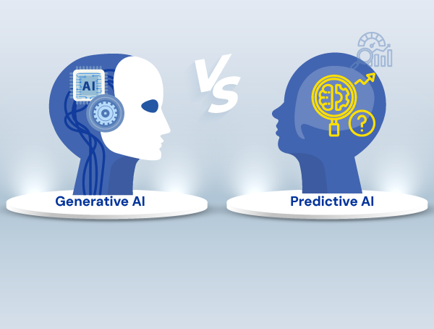
INTEGRATION: PREDICTIVE AI MEETS GENERATIVE AI
The integration of predictive AI (focused on forecasting outcomes from historical data) and generative AI (focused on creating new content and simulations) is creating powerful hybrid AI systems that combine foresight with creative action.

Slide 21
Integrated Workflow
Collect & analyze data (predictive)
Generate forecasts & insights
Use generative AI to create reports, visuals, alerts
Disseminate results widely

Slide 22
Benefits of AI for Environmental Health
Faster decisions
Better public communication
Streamlined reporting
Early warning systems

Slide 23
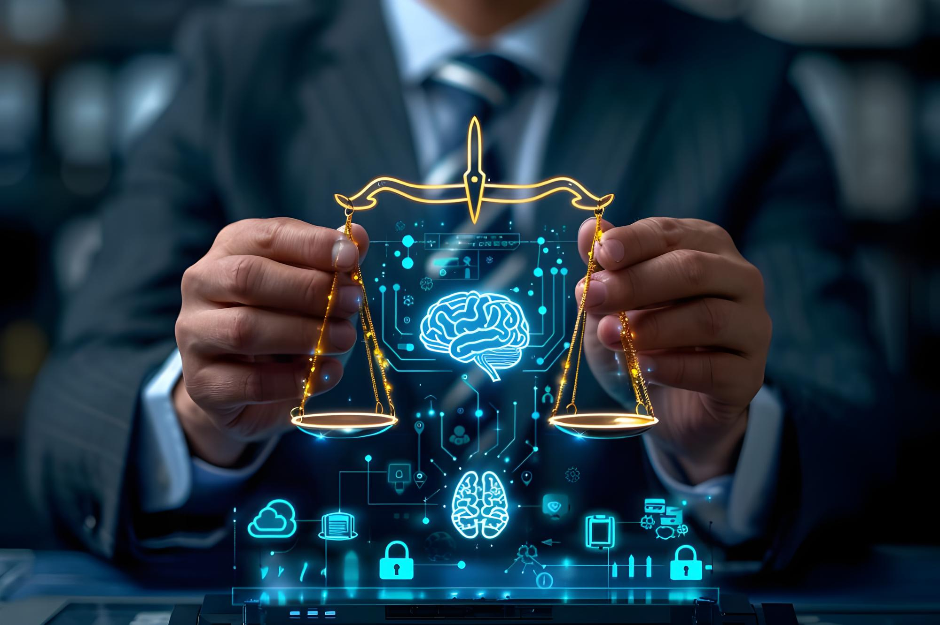
AI ETHICS AND GOVERNANCE
AI ethics and governance are the interconnected frameworks of moral principles and practical policies/regulations that ensure artificial intelligence technologies are developed and deployed responsibly, safely, and for the benefit of humanity

Slide 24
AI Ethics And Governance
Data privacy & security
Transparency & accountability
Fairness & bias mitigation
Importance of human supervision
Safeguarding AI systems

Slide 25
AI Environmental Global Use Cases

Slide 26
AI Environmental Global Use Cases
1. AI-Powered Deforestation Detection & Risk Prediction
Use Case ID: UC-WASTE-002
Actors / Stakeholders: Waste-collection teams, Waste-management organizations, Environmental NGOs (e.g. CleanHub), Data auditors, Local governments, Community members
Preconditions:
Existence of an app or digital system where collection teams log recovered plastic waste (with metadata: weight, photos, location, timestamp).
Availability of AI software trained to validate entries (image analysis, weight anomaly detection, etc.).
Clear policies and standards for safety and compliance (e.g., workers must wear protective gear).
Description / Flow:
Collection teams retrieve plastic waste from designated areas (communities, coasts, rivers, etc.).
During collection, the team uses the mobile app to log each collection event: enters data (weight, type, location) and uploads one or more photos depicting the waste and collection environment.
Once submission is made, the AI system analyzes the submission:
Checks image compliance (detects whether workers are wearing safety gear like gloves/shoes).
Verifies that the weight entered matches the scale reading shown in the image (image weight mismatch).
Flags entries where weight or other data fall outside the expected norms for that collection hub (data weight outlier).
If any inconsistency or flag arises, the system marks the submission for review / audit.
Auditors or administrators review flagged submissions; if confirmed invalid, the collection data is corrected or discarded.
Validated data is stored and aggregated — giving accurate, trustworthy data on plastic waste recovered.

Slide 27
AI Environmental Global Use Cases
1. AI-Powered Deforestation Detection & Risk Prediction, Con`t
Use Case ID: UC-WASTE-002
Postconditions / Outcomes:
Higher data integrity and transparency in plastic waste recovery operations. Increased compliance with safety standards for waste-collection workers.
Reliable reporting for stakeholders (NGOs, regulators, partners) about actual recovery volumes.
Better decision-making based on accurate data — e.g., where to allocate resources, how to map waste hotspots, track progress over time.
Benefits
Protects ecosystems & biodiversity
Reduces carbon emissions
Strengthens data-driven environmental management
Challenges
Accuracy depends on image quality
Requires technical capacity & funding
Risk of false positives/negatives
Countries Using This:
Brazil – monitoring Amazon deforestation with satellite-AI systems
Indonesia – tracking forest loss due to palm oil expansion
Congo (DRC) – monitoring illegal logging in the Congo Basin
Madagascar – identifying high-risk zones for forest fires and land clearing

Slide 28
AI Environmental Global Use Cases
1. AI-Driven Detection and Removal of Ocean Plastic Pollution
Use Case ID: UC-OCEAN-003
Actors / Stakeholders: Marine cleanup organizations (e.g. The Ocean Cleanup), Marine researchers, Environmental NGOs, Autonomous robotics developers, Satellite data providers, Governments/coastal authorities
Preconditions:
Access to satellite imagery or aerial imagery (for surface-level plastic detection) over ocean expanses.
ML / computer vision models trained to recognise plastic debris in water from imagery (surface and possibly sub-surface).
Optionally: autonomous boats or robots equipped with sensors / cameras, capable of ocean navigation and debris collection.
Logistics for deployment and retrieval of cleanup systems.
Description / Flow:
Periodically capture satellite or aerial imagery covering targeted ocean regions (e.g., known garbage patches, coastal zones, remote marine areas).
Feed images into AI / machine-learning models that detect and locate aggregations of plastic debris floating on or near the ocean surface.
Generate pollution maps showing concentration, location, size, and distribution patterns of plastic waste.
Use the maps to plan cleanup operations — e.g., deploy autonomous boats or marine robots to highest-density zones first.
Deploy autonomous cleanup robots (or human-guided vessels) — robots may be equipped with cameras and suction mechanisms (or nets), and use AI onboard for navigation and debris recognition / collection.
Collected waste is retrieved, logged, and processed through recycling/waste-management channels. Cleanup progress and effectiveness is tracked via AI-informed monitoring (before-and-after imagery, debris counts, volume estimates).

Slide 29
AI Environmental Global Use Cases
1. AI-Driven Detection and Removal of Ocean Plastic Pollution, Con`t
Use Case ID: UC-OCEAN-003
Postconditions / Outcomes:
Accurate mapping of ocean plastic pollution — giving visibility into previously hard-to-monitor remote regions.
Efficient deployment of cleanup resources — prioritizing high-impact zones.
Collection and removal of plastic debris from oceans at scale, reducing environmental harm to marine life and ecosystems.
Data-driven tracking of cleanup progress and impact over time.
Benefits:
Helps restore marine ecosystems and protects marine biodiversity by removing harmful waste.
Reduces long-term environmental damage (to fish, mammals, birds) and potential contamination of food chains.
Enables transparent reporting and impact measurement, useful for NGOs, governments, donors.
Risks / Challenges
Small or hidden plastics are hard to detect from satellites or drones.
Ocean conditions (waves, glare, turbidity) reduce detection accuracy.
Autonomous robots must withstand rough seas; maintenance is difficult.
Cleanup systems may risk harming marine life if not designed carefully.
Continuous funding and coordination are needed for ongoing monitoring and cleanup.
Countries Using This:
USA – Pacific Ocean cleanup operations
Netherlands – deployment of autonomous cleanup system
Japan – monitoring coastal plastic flows
Malaysia – detection of river-plastic channels
Fiji – AI mapping of marine debris in vulnerable island ecosystems

Slide 30
Thank You

