Slide 1
ENVIRONMENTAL HEALTH COUNCIL OF NIGERIA (EHCON)
IN COLLABORATION WITH
AFRI TOURISM INVESTMENT LTD
WORKSHOP AND TRAINING PROGRAMME
How to Access and Use The AI Tools

Slide 2

Outline
Introduction to AI Tools
Accessing ChatGPT
Accessing Claude AI
Accessing Microsoft Copilot
Accessing KNIME

Slide 3
Introduction to AI Tools
What AI is
Generative AI
Predictive Analytics
Why it matters

Slide 4
ChatGPT

Slide 5
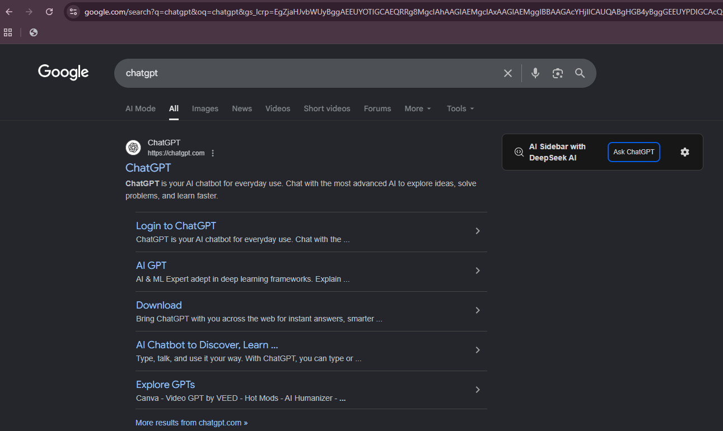
Accessing ChatGPT
1. Search 'ChatGPT' on Google

Slide 6
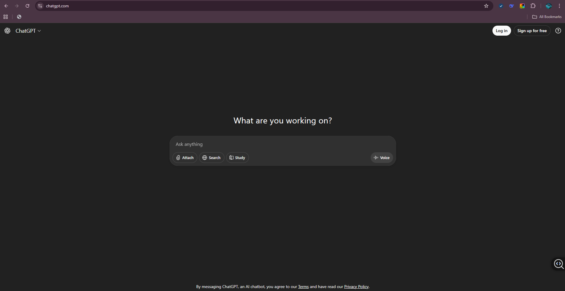
Accessing ChatGPT
2. Go to chat.openai.com

Slide 7
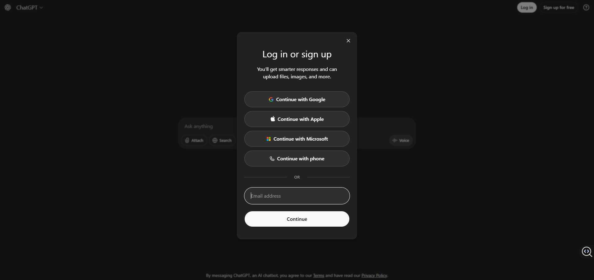
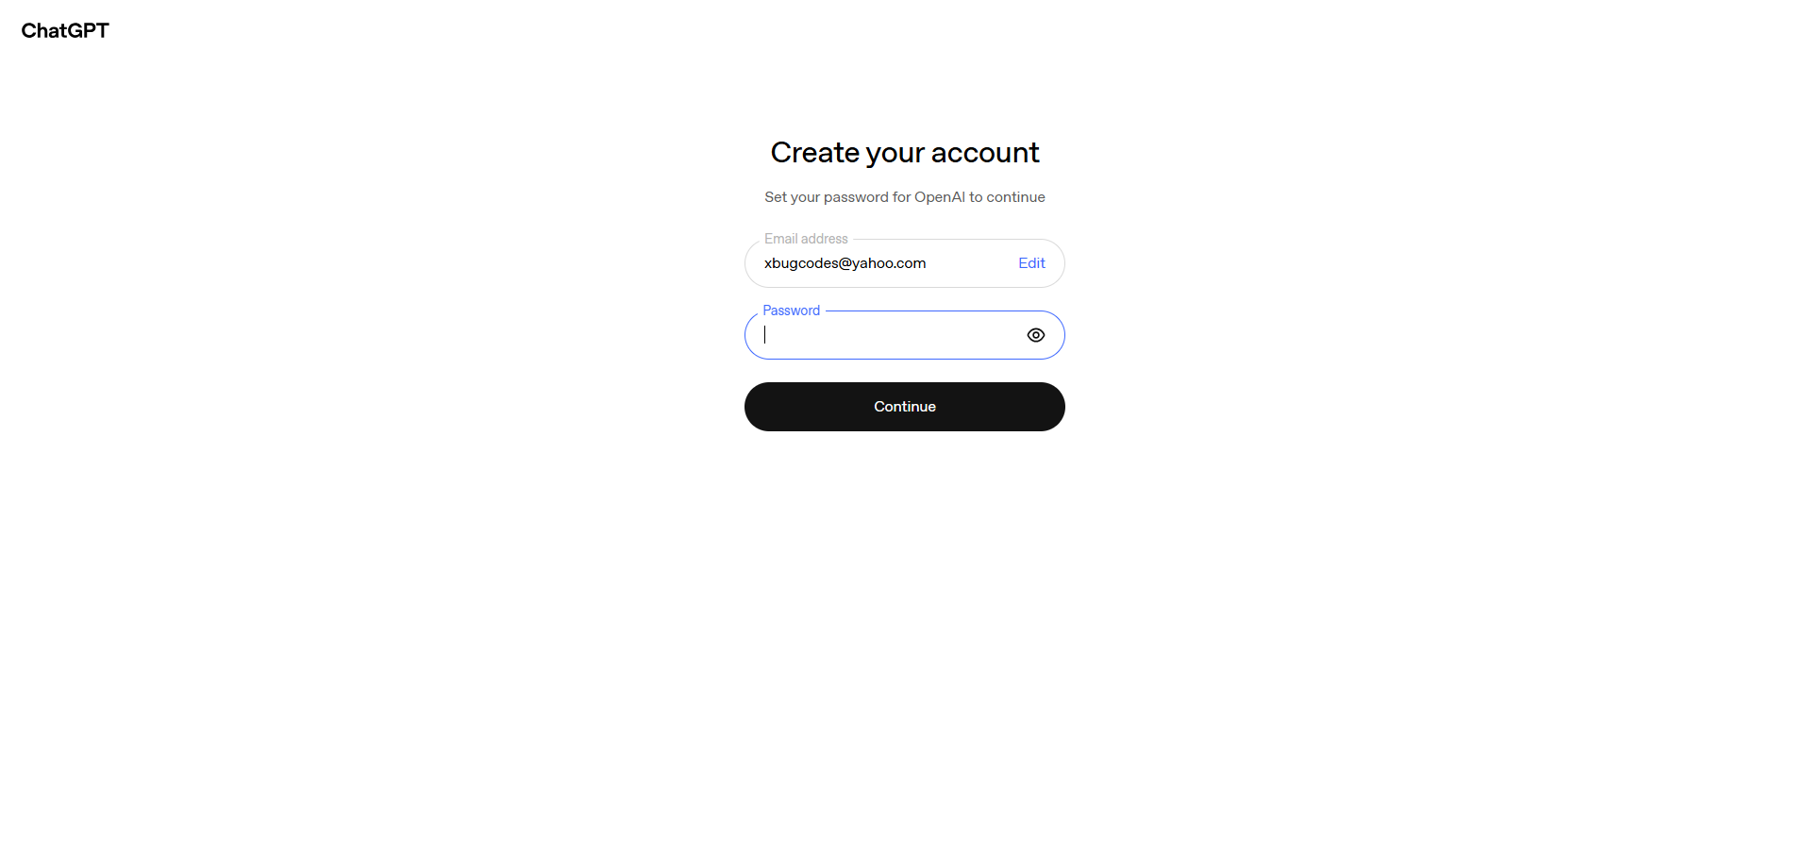
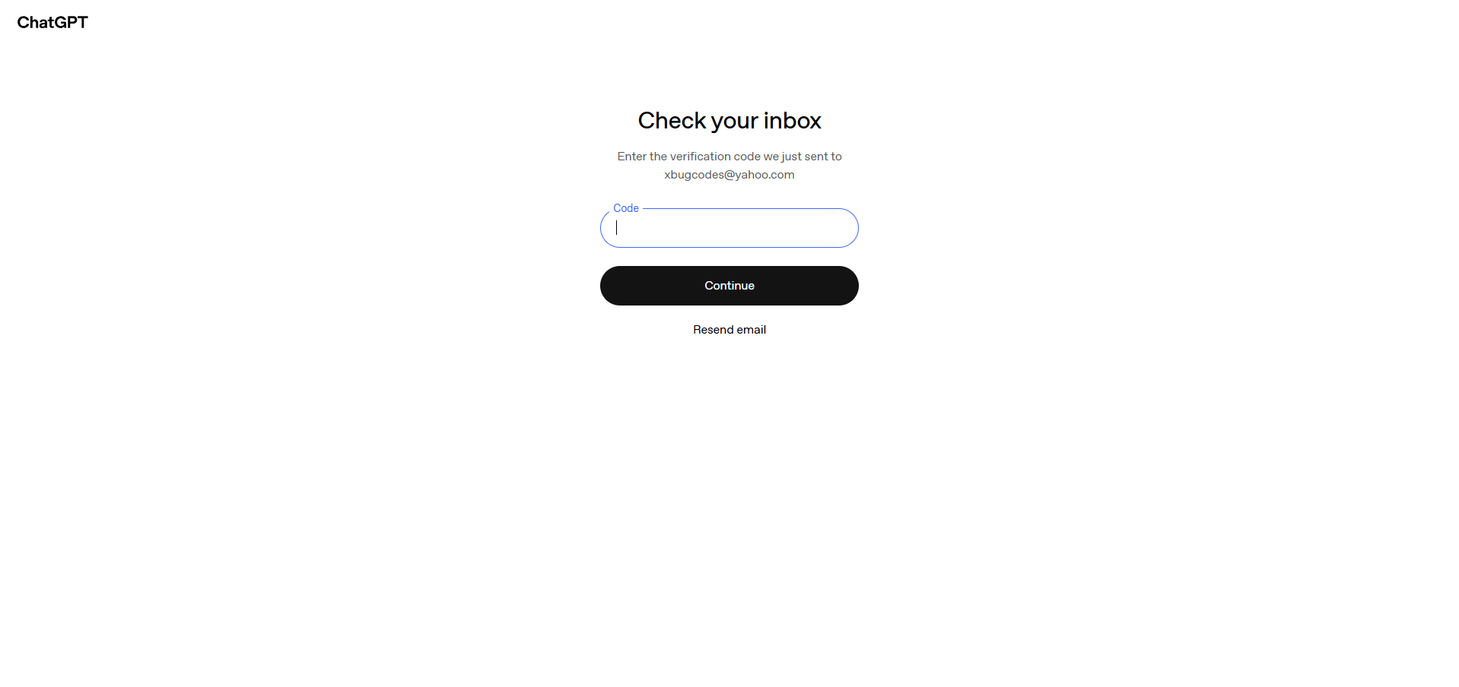
Accessing ChatGPT
3. Create Account

Slide 8
Accessing ChatGPT
4. Login

Slide 9
Accessing ChatGPT
5. Start Chatting with the AI Model

Slide 10
Claude AI

Slide 11
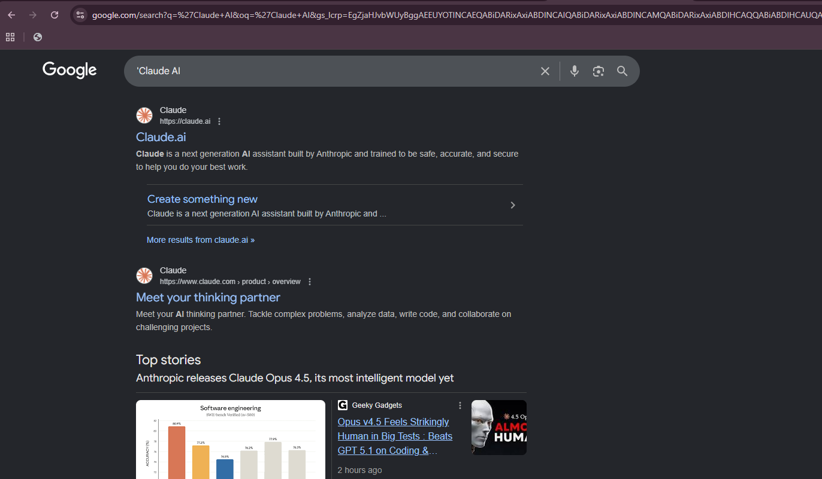
Accessing Claude AI
1. Search 'Claude AI' on Google

Slide 12
Accessing Claude AI
1. Search 'Claude AI' on Google

Slide 13
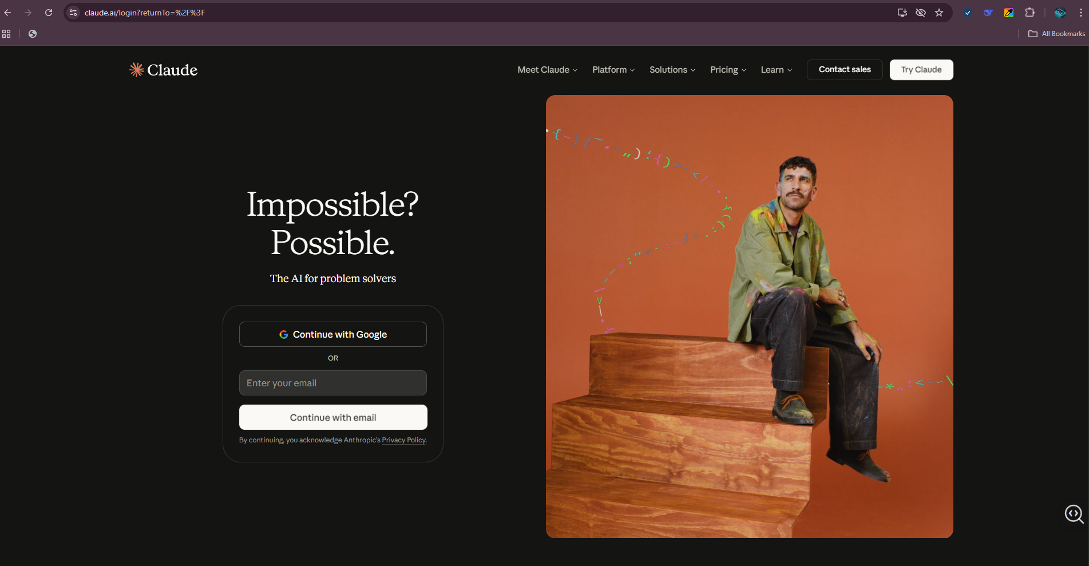
Accessing Claude AI
2. Go to Claude.ai

Slide 14
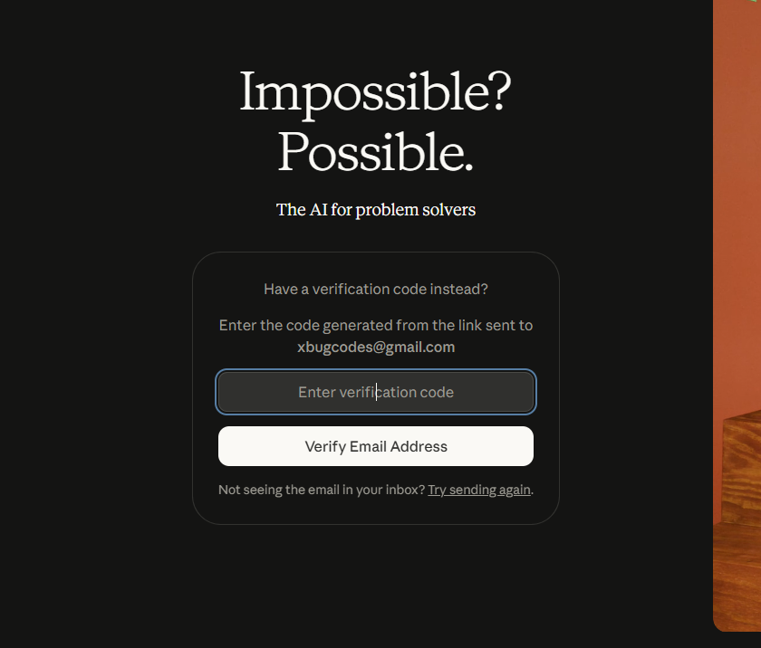
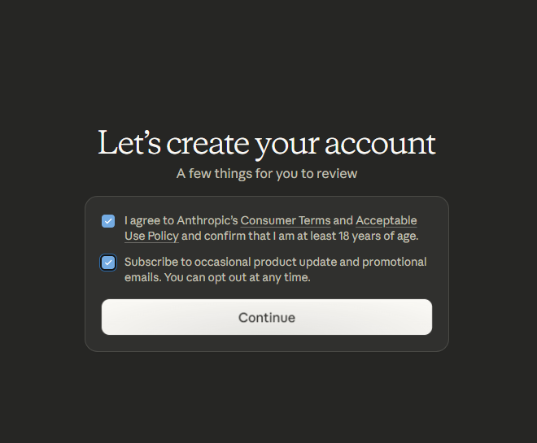
Accessing Claude AI
3. Create Account & Login
Enter your Email Address then click continue to proceed
An Email will be sent to you for verification, you will have to verify it and continue
Then you need to agree to there terms and Policy’s then continue
Verify Phone number then proceed.

Slide 15
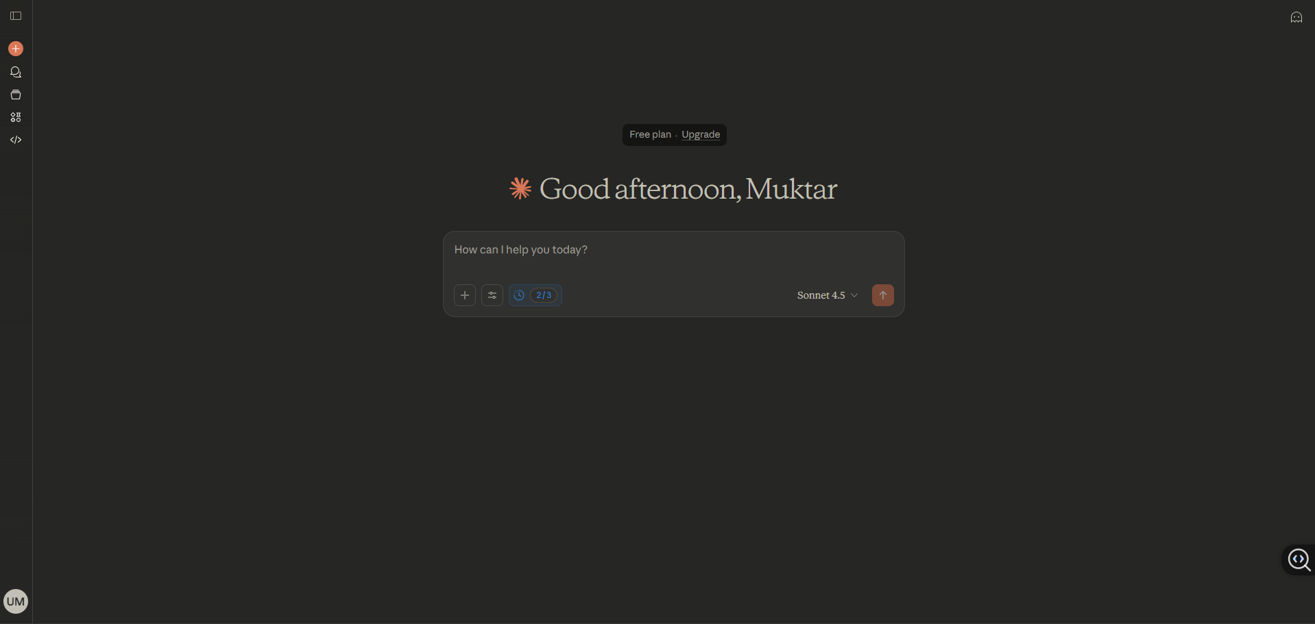
Accessing Claude AI
4. Start Chatting with Claude AI Model

Slide 16
Microsoft Copilot

Slide 17
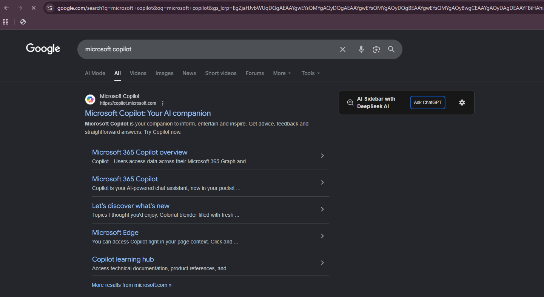
Accessing MS Copilot
1. Search 'Microsoft Copilot'

Slide 18
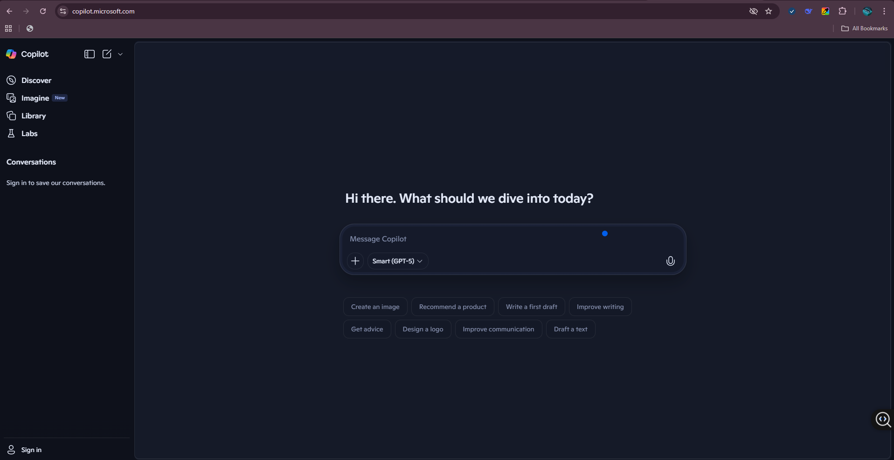
Accessing MS Copilot
2. Go to copilot.microsoft.com

Slide 19
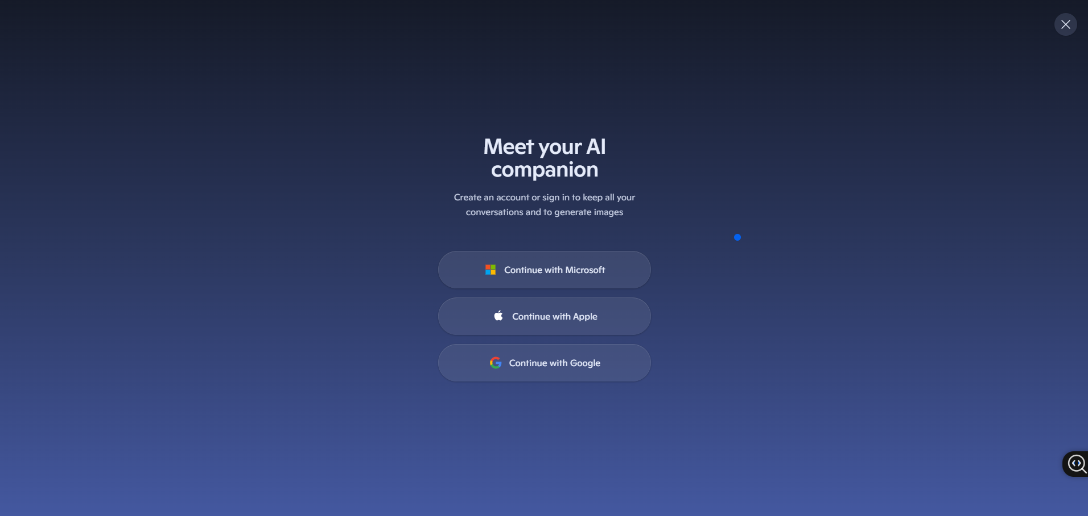
Accessing MS Copilot
3. Create Account & Login
Select Any of the three options to log-in
Confirm you email by the service provider then it will redirect you back to home /chat page of the app.

Slide 20
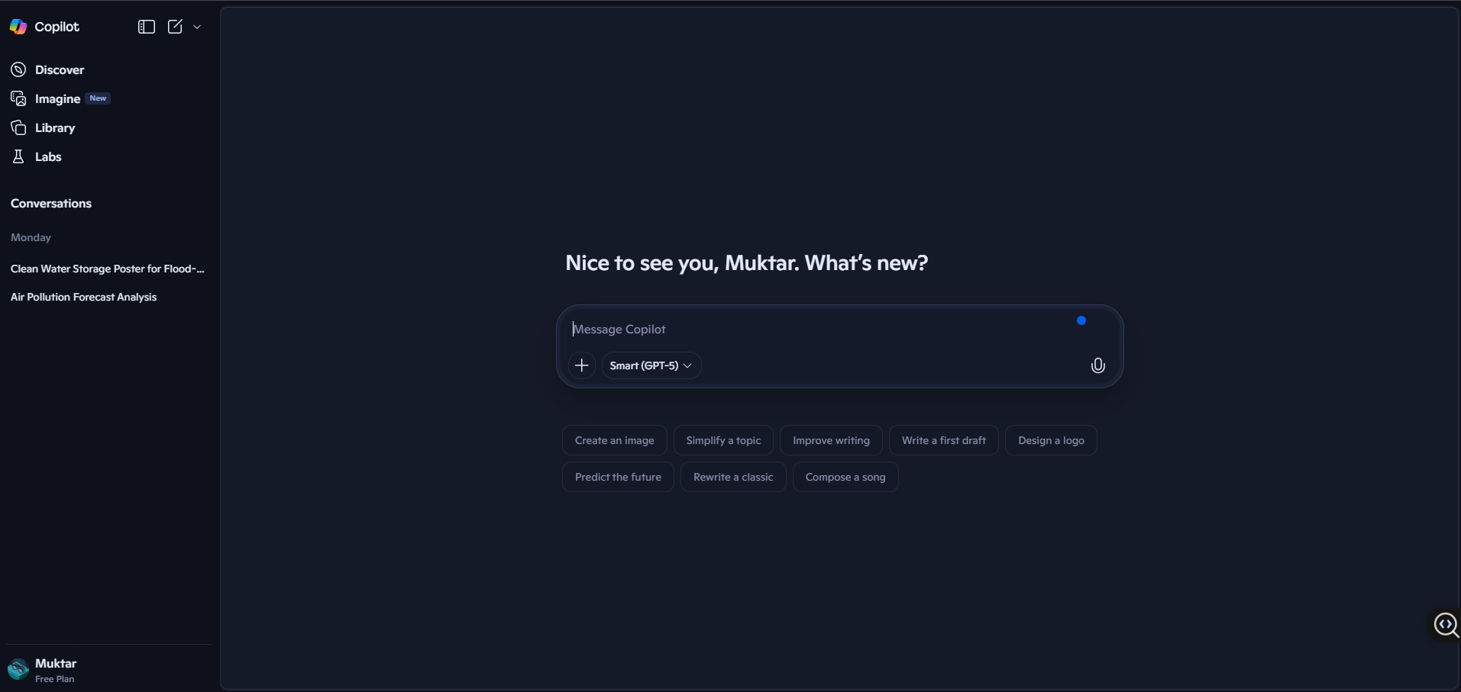
Accessing MS Copilot
4. Start Chatting with Microsoft Copilot

Slide 21
KNIME Analytics Platform

Slide 22
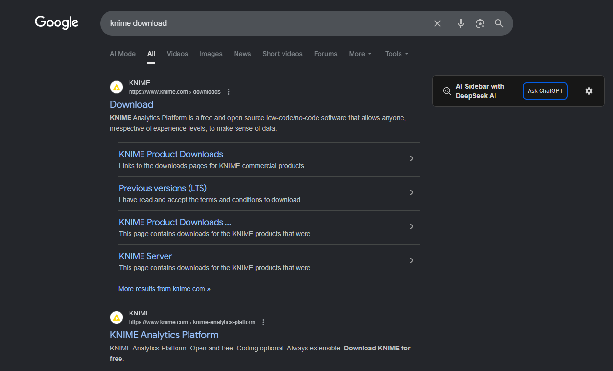
Accessing KNIME
1. Search ’KNIME Download’ on Google

Slide 23
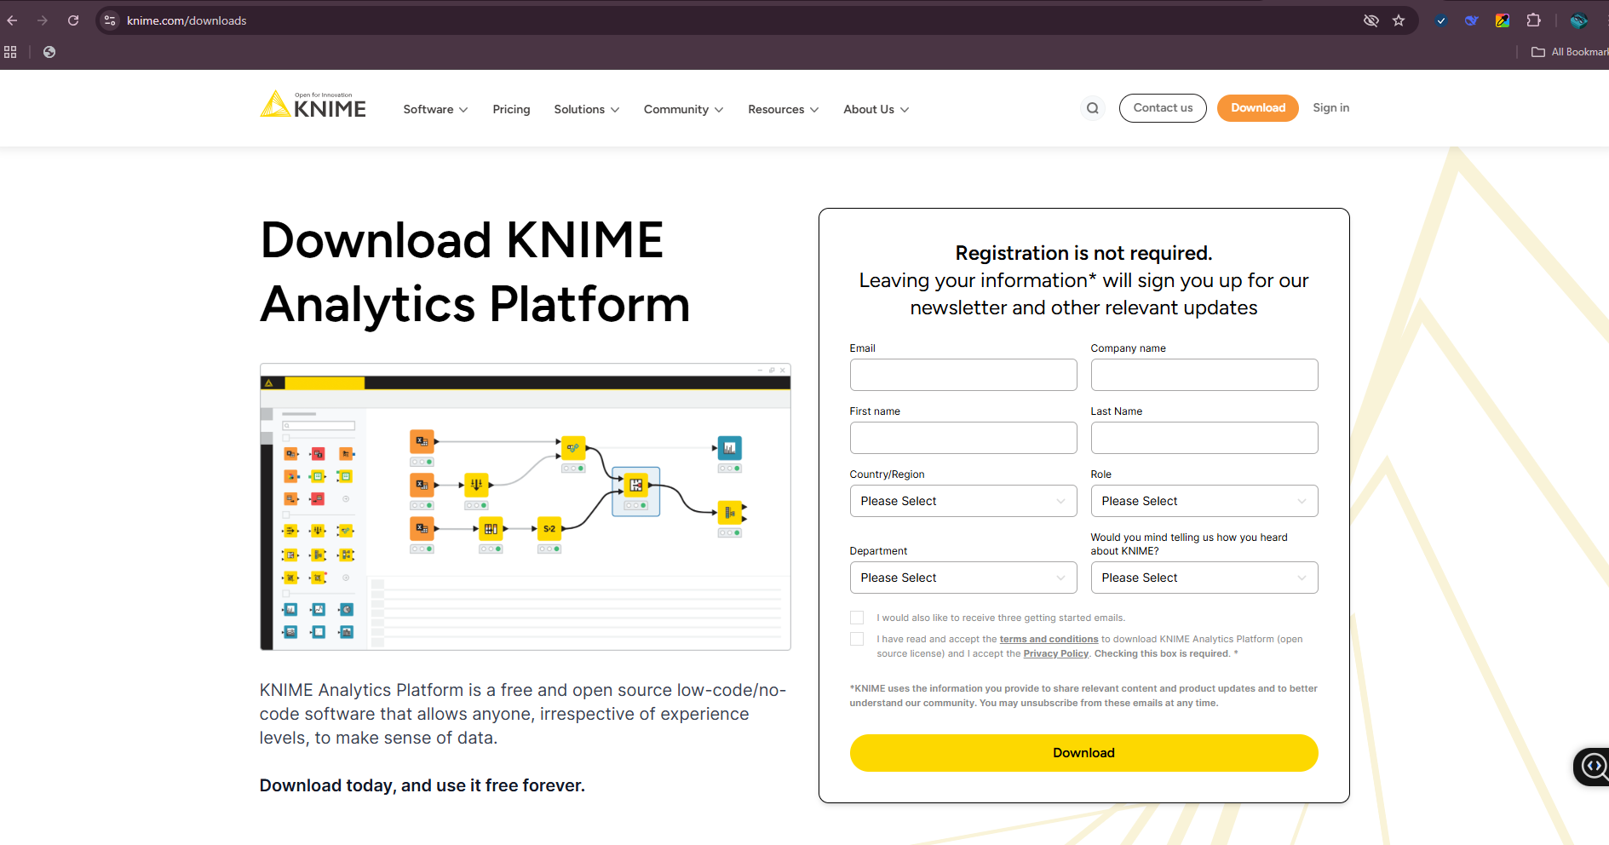
Accessing KNIME
2. Download Page
Fill-in the Registration Form and then Proceed to clicking Download
Then the KNIME Analytical Tool will be downloaded on your device(KNIME 5.8.0 Installer (64bit).exe), you can now proceed to installing it on your PC.

Slide 24
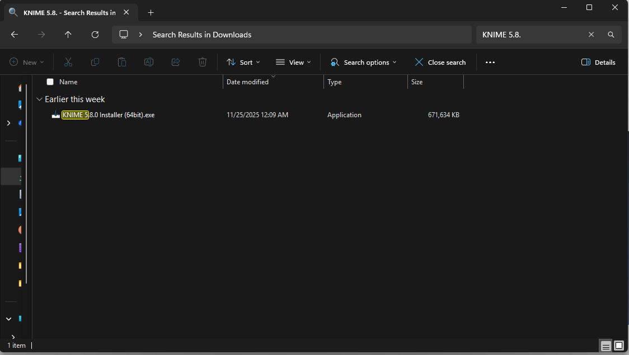
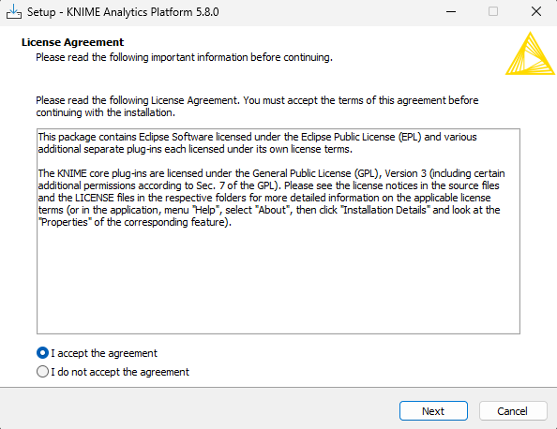
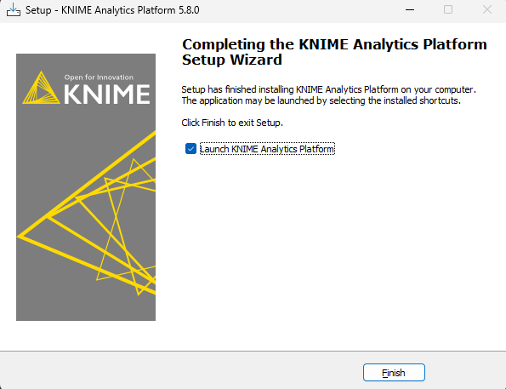
Accessing KNIME
3. Downloads Folder
You can open your PC’s File Explorer and go to /Downloads Folder, in side the folder you will see you Downloaded KNIME(.exe file)
Double-Click on it to install it on toy PC: Follow the installation process to complete the installation.
Make sure to accept the agreement.
Once the Installation is completed then Click on the Finish Button, and launch the application(KNIME)

Slide 25
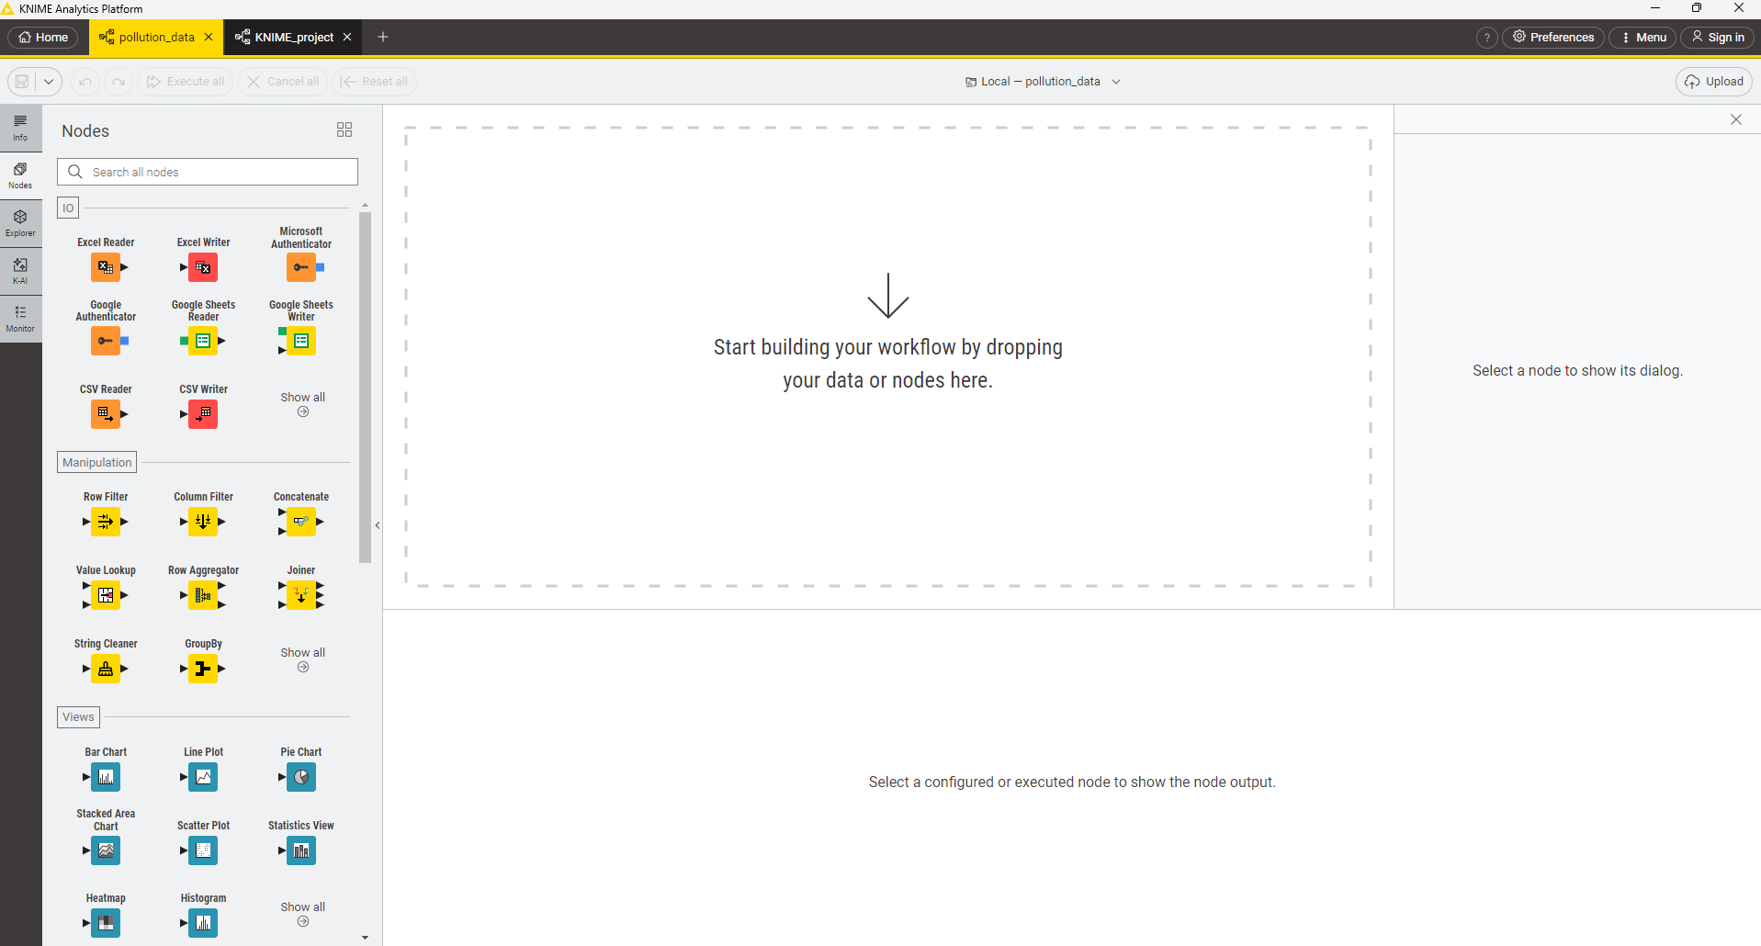
Accessing KNIME
4. Start Using KNIME for Analysis

Slide 26
Thank You

Slide 27
Getting Started with the Tools

Slide 28

ChatGPT
Open chat.openai.com.
Paste or upload your dataset summary (e.g., pollution readings or sanitation scores).
Use structured prompts (see Exercise 1 & 3 on manual).
Review and refine ChatGPT’s reasoning.
Copy outputs into Word or PowerPoint for presentations.
Prompt: Dataset(upload): pollution_readings.csv
Analyze this dataset and forecast the pollution level for next week. Summarize your reasoning.

Slide 29

MicroSoft Copilot
Open Excel and upload your dataset (CSV or XLSX).
Click on Copilot in the toolbar.
Ask questions like “Forecast pollution levels for the next week based on column X”.
Copilot will generate a chart and summary.
Export the output into Word for documentation.
Prompt: Dataset(upload): pollution_readings.csv
Analyze this dataset and forecast the pollution level for next week. Summarize your reasoning.

Slide 30

Claude AI
Go to claude.ai.
Upload documents (inspection reports, datasets, or policies).
Prompt Claude with instructions like “Summarize this document into key findings for decision makers.”
Copy the response and refine with ChatGPT if needed
Prompt: Dataset(upload): inspection_report_sample.txt
Summarize this document into key findings for decision makers.

Slide 31

KNIME Analytics Tool
Install KNIME Analytics Platform.
Create a new workflow.
Import your dataset (CSV or Excel).
Add nodes: File Reader → Data Preprocessing → Partitioning → Learner (e.g., Decision Tree, Random Forest) → Predictor → Scorer.
Execute workflow and visualize results.
Export results to Excel or CSV for visualization or use in ChatGPT

